Slide 1
Chapter 5
Part-of-Speech Tagging

Slide 2
Syntax
Syntax is the study of relationship between the words in a sentence
How words in a sentence are clustered into classes called Part-of-Speech (POS)?
How they group with their neighborhood into phrases?
The way the words depends on other words in a sentence
Explore different computation models for this
The significance of parts-of-speech (also known as POS, word classes, morphological classes, or lexical tags) for language processing is the large amount of information they give about a word and its neighbors

Slide 3
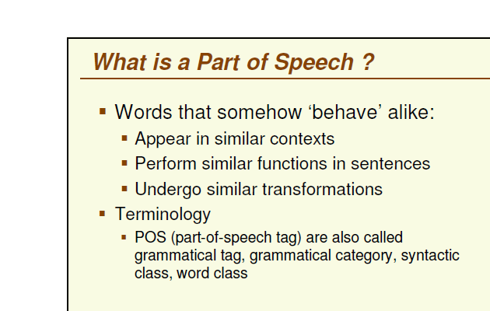

Slide 4
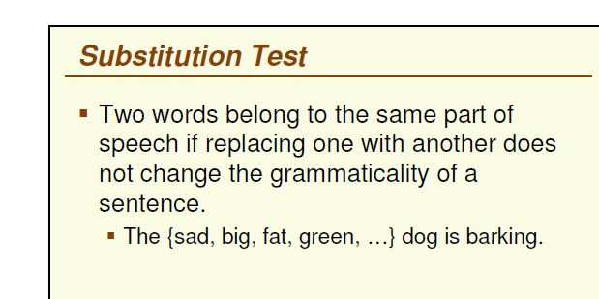

Slide 5
Different computational model
Context-free grammars
Lexicalized grammars
Feature structure
Meta theoretical issues like Chomsky hierarchy

Slide 6
Word classes and Part of Speech – Quotes
“Conjuction, junction, what’s your problem” – Bob Dorough
“There are ten parts of speech and they are all troublesome” – Mark Twain
- In 100 B.C Dionysius Thrax of Alexandria or Perhaps someone else wrote grammatical sketch of Greek (a “techne”).
-It is astonishing source of our modern linguistic.
-Contains description of eight POS: noun, pronoun, adjective, verb, adverb, conjunction, participle and article.

Slide 7
Part of Speech
Most recent lists of POS (also known as the morphological classes or lexical tags) have number of classes.
Tagsets:
Penn Treebank 45
Brown corpus 87
More POS tags – finer the details

Slide 8
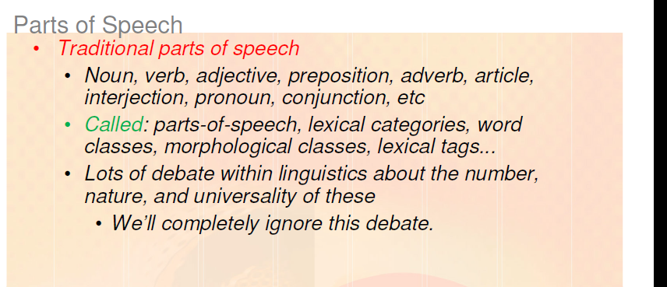

Slide 9
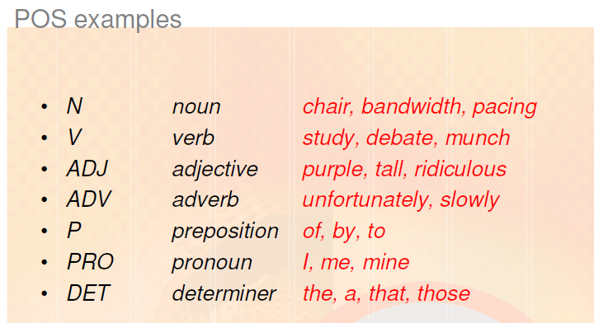
Note: Tagsets are not used here

Slide 10
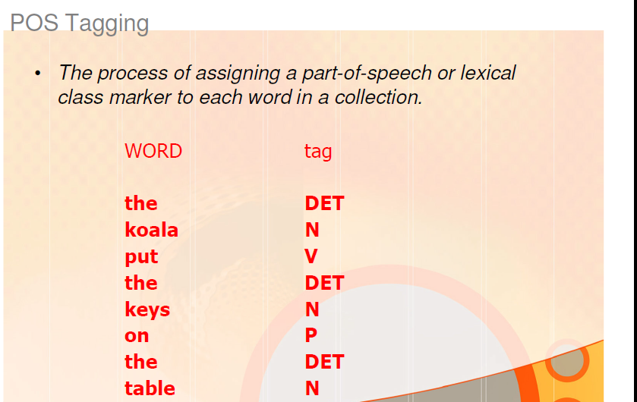
Note: Tagsets are not used here

Slide 11
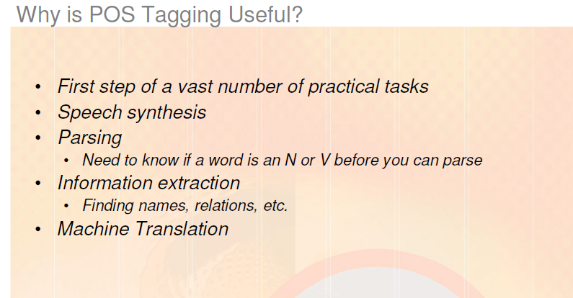
Note: Corpora that have been marked for parts-of-speech are very useful for linguistic research
Ex: They can be used to help find instances or frequencies of particular constructions

Slide 12


Technologies
Speech recognition
Spoken language is recognized and transformed in into text as in dictation systems, into commands as in robot control systems, or into some other internal representation.
Speech synthesis
Utterances in spoken language are produced from text (text-to-speech systems) or from internal representations of words or sentences (concept-to-speech systems)

Slide 13
Speech Synthesis
part-of-speech can tell about how the word is pronounced
the word content, can be a noun or an adjective
They are pronounced differently
(the noun is pronounced CONtent and the adjective conTENT)
(Other pairs like this include OBject (noun) and obJECT (verb), DIScount (noun) and dis-COUNT (verb)
Knowing the part-of-speech can produce more natural pronunciations in a speech synthesis system and more accuracy in a speech recognition system

Slide 14
Part of Speech
POS gives significant amount of information about each word and its neighbors
This is clearly there for major categories (nouns and verbs)
But it is also true for finer distinctions
For example these tagsets distinguish between possessive pronouns (my, your, his, her, its) and Personal pronouns(I, you, he, me).
Possessive pronouns are likely to be followed by a noun:
This is my book. PP$ tag for “This”, “my” in Penn tagset
Personal pronoun are likely followed by a verb:
I went to Mumbai. PP tag for “I” in Penn tagset

Slide 15
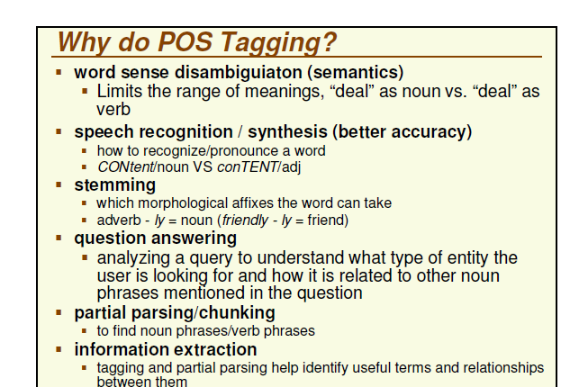

Slide 16
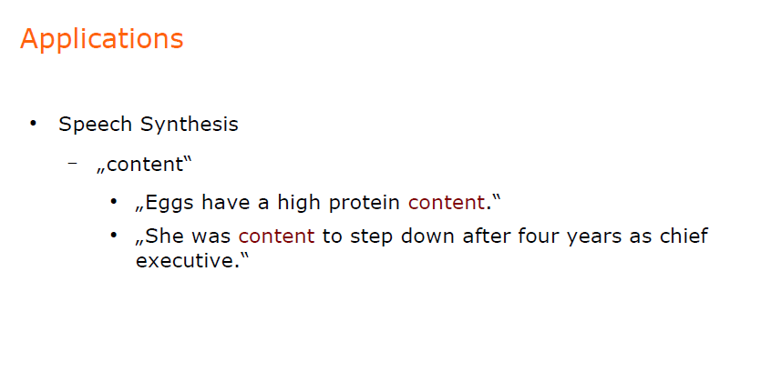

Slide 17
Applications - Speech Synthesis
Distinguish heterophones in speech synthesis :
“I did not object to the object.”
“To present the present. ”
“The bandage was wound around the wound.”

Slide 18
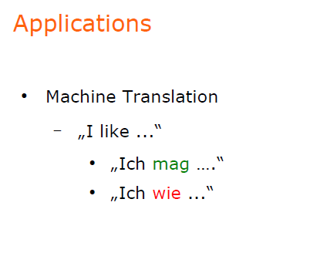

Slide 19
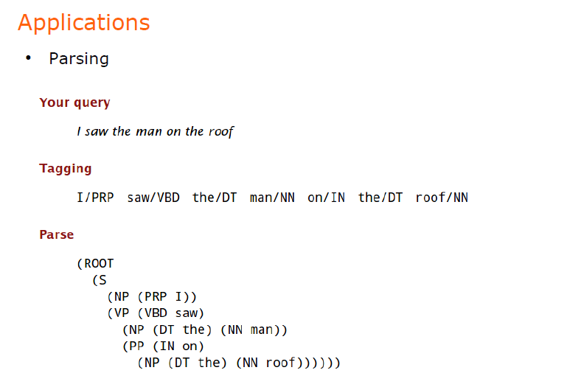

Slide 20
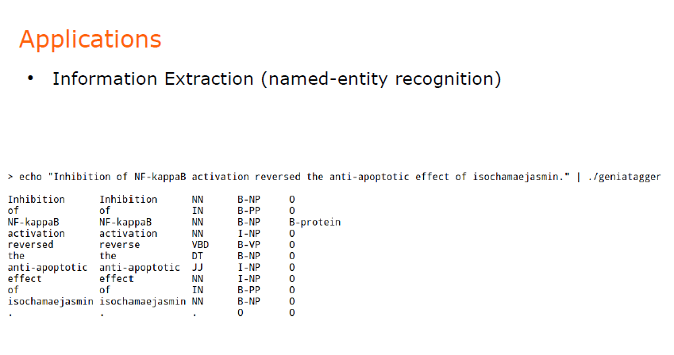

Slide 21
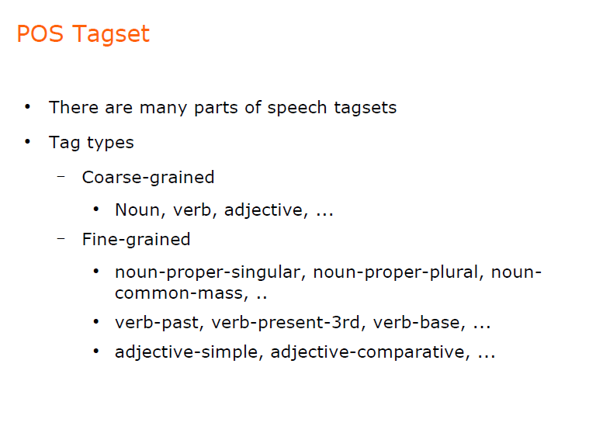

Slide 22
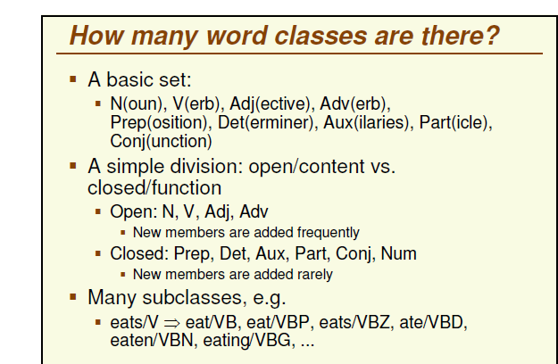

Slide 23
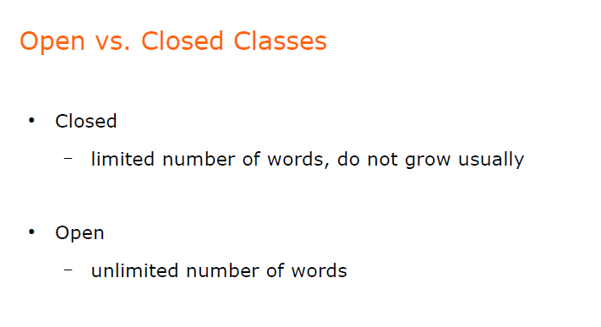

Slide 24
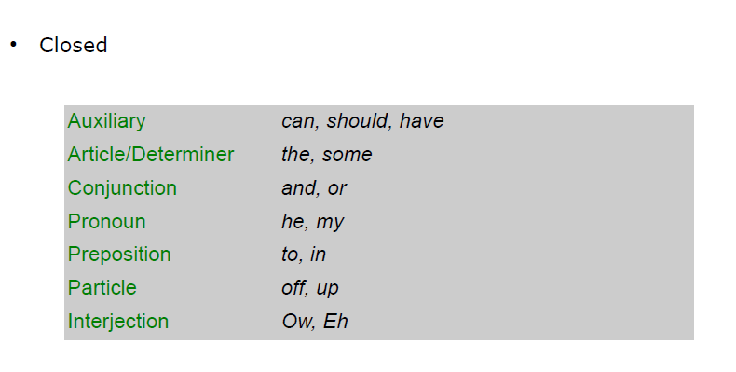

Slide 25
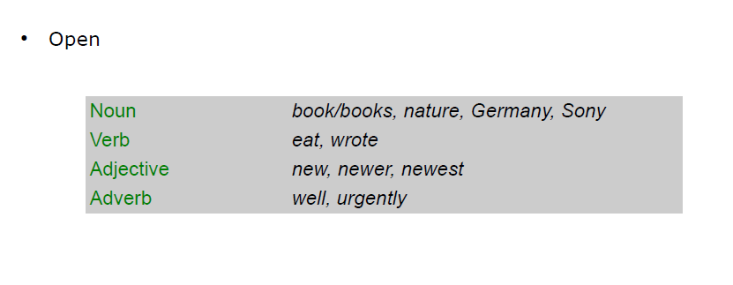

Slide 26
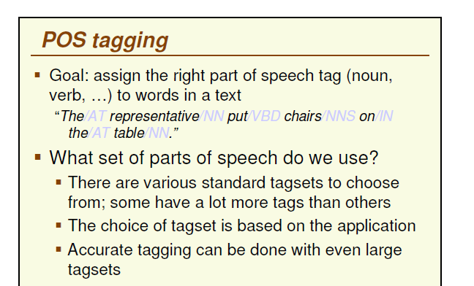
Note: Tagsets were not used here

Slide 27
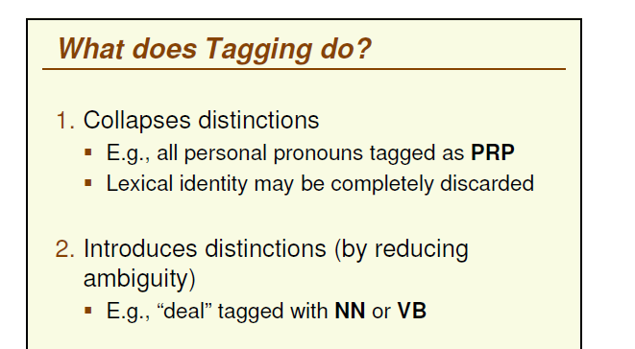

Slide 28
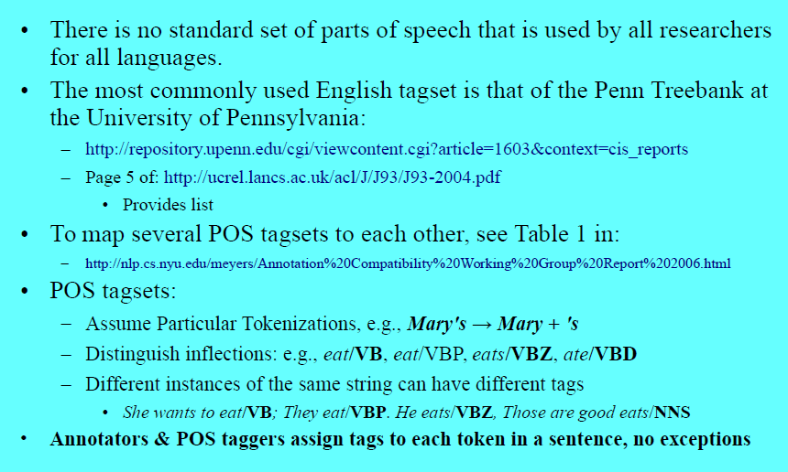
POS Tag Standards

Slide 29
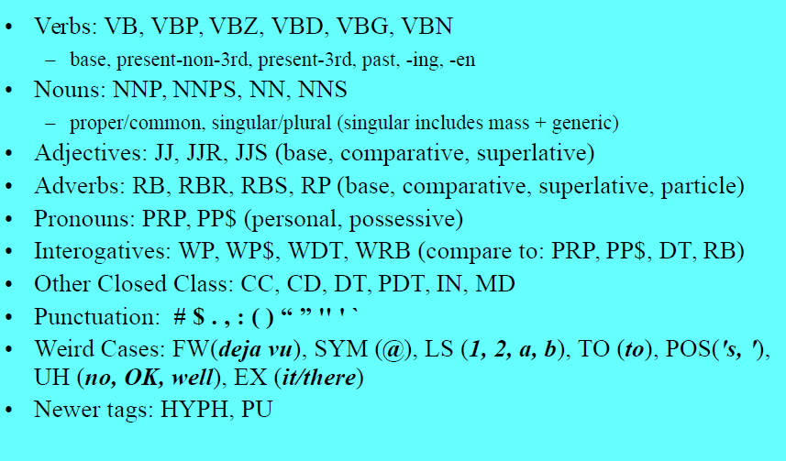
The Penn tree bank II POS Tag Set
VBG – Verb Gerund- ex: eating - Gerunds are words that are formed with verb but act as nouns. Every gerund is a verb with -ing tacked to its tail. There are no exceptions to this rule.

Slide 30
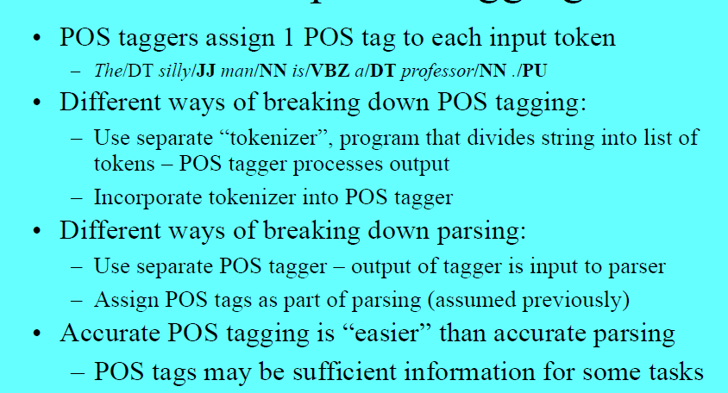
The POS Tagging

Slide 31
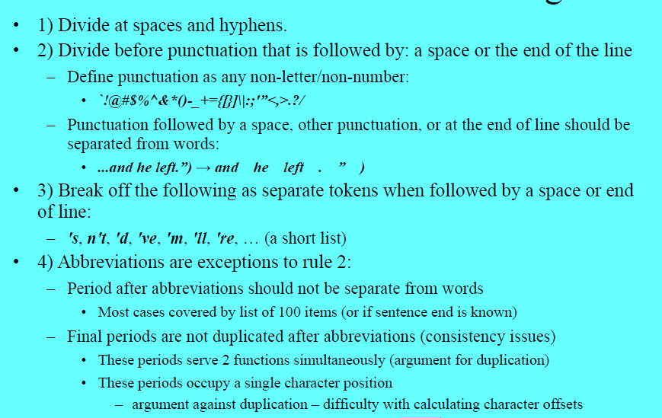
Some Tokenization rules for English

Slide 32
Some Tokenization rules for English

Slide 33
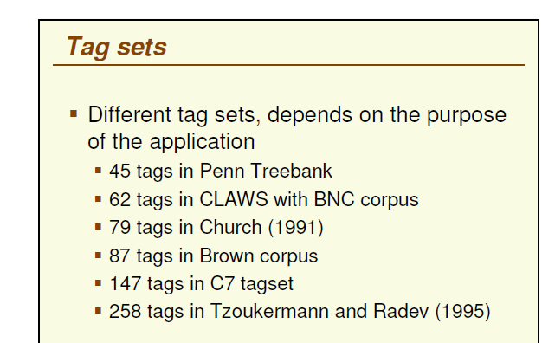

Slide 34
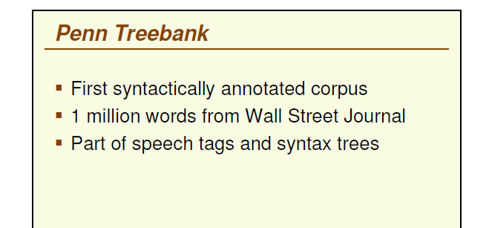

Slide 35
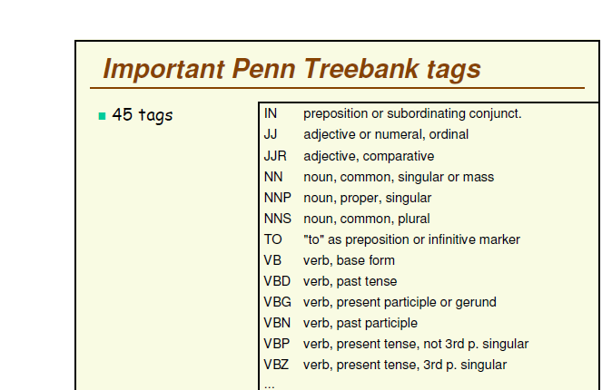
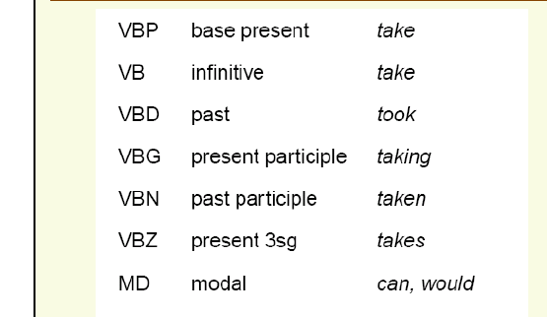

Slide 36
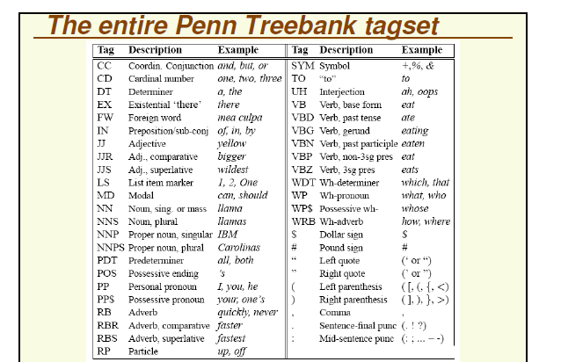
Prepositions and subordinating conjunctions marked IN (although/IN)

Slide 37
Examples
The grand jury commented on a number of other topics.
Ex1: Determiners: the and a,
the adjectives grand and other,
the common nouns jury, number, and topics,
the past tense verb commented
There are 70 children there
Ex2: EX tag - to mark the existential There construction in English
Another use of there which is tagged as an adverb (RB).
Although preliminary findings were reported more than a year ago, the latest results appear in today's New England Journal of Medicine,
Ex3: segmentation of the possessive morpheme -'s,
a passive construction `were reported' in which the verb reported is marked as a past participle (VBN), rather than a simple past (VBD).
the proper noun New England is tagged NNP.
New England Journal of Medicine is a proper noun, the Tree-bank tagging chooses to mark each noun in it separately as NNP, including journal and medicine, which might otherwise be labeled as common nouns (NN)

Slide 38
Examples
The grand jury commented on a number of other topics.
The/DT grand/JJ jury/NN commented/VBD on/IN a/DT number/NN of/IN other/JJ topics/NNS ./.
There are 70 children there
There/EX are/VBP 70/CD children/NNS there/RB
Although preliminary findings were reported more than a year ago, the latest results appear in today's New England Journal of Medicine,
Although/IN preliminary/JJ findings/NNS were/VBD reported/VBN more/RBR than/IN a/DT year/NN ago/IN ,/, the/DT latest/JJS results/NNS appear/VBP in/IN today/NN ’s/POS New/NNP England/NNP Journal/NNP of/IN Medicine/NNP ,/,
“many, some, much>more>most.”, “ late>later>latest”

Slide 39
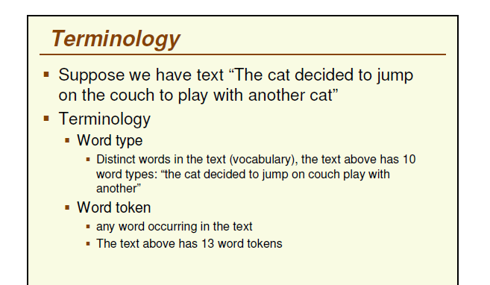

Slide 40
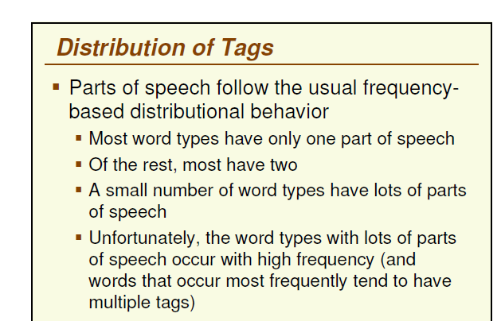

Slide 41
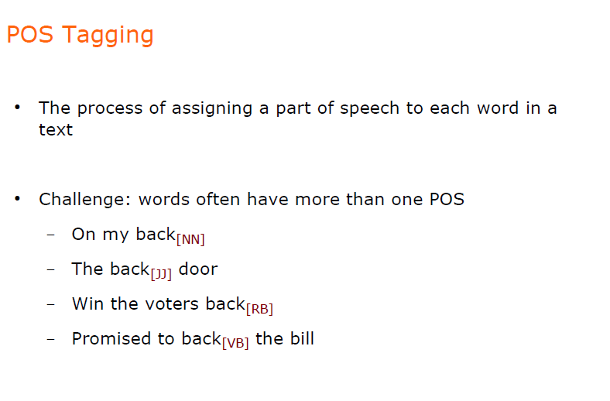

Slide 42
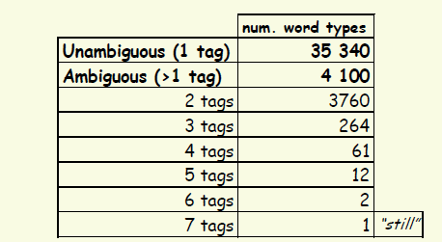
Word Class Ambiguity (in the Brown Corpus)
Unambiguous (1 tag): 35,340
Ambiguous (2-7 tags): 4,100
(Derose, 1988)

Slide 43
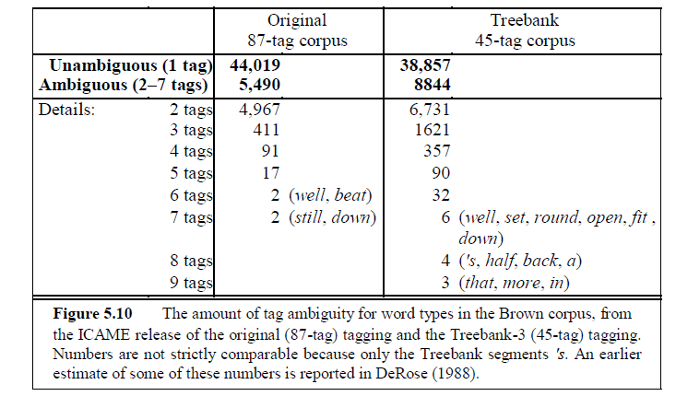
Word Class Ambiguity Brown vs Penn Tag set Corpus

Slide 44
5.3 POS Tagging
the 45-tag corpus has more ambiguity than the 87-tag corpus
Many of the 40% ambiguous tokens are easy to disambiguate.
This is because the various tags associated with a word are not equally likely.
Ex: a can be a determiner, or the letter a (perhaps as part of an acronym or an initial). But the determiner sense of a is much more likely.

Slide 45
5.3 POS Tagging
Part-of-speech tagging (or tagging) is the process of assigning a part-of-speech or other syntactic class marker to each word in a corpus.
Because tags are generally also applied to punctuation, tagging requires that the punctuation marks (period, comma, etc) be separated off of the words.
Thus tokenization (Ch. 3) is performed as part of the tagging process separating commas, quotation marks, etc., from words, and disambiguating end-of-sentence punctuation (period, question mark, etc) from part-of-word punctuation (such as in abbreviations like e.g. and etc.)

Slide 46
5.3 POS Tagging
The input to a tagging algorithm is a string of words and a specified tagset
The output is a single best tag for each word.

Slide 47
5.3 POS Tagging - Ambiguity
Automatically assigning a tag to each word is not trivial.
Ex1: book is ambiguous.
it has more than one possible usage and part-of-speech.
It can be a verb
Ex: book that flight or to book the suspect) or
a noun
Ex: hand me that book, or a book of matches).
Ex2: that can be a determiner
Ex: Does that flight serve dinner
or a complementizer
Ex: I thought that your flight was earlier.
The problem of POS-tagging is to resolve these ambiguities, choosing the proper tag for the context.
Part-of-speech tagging is one of the many disambiguation tasks.

Slide 48
5.3 POS Tagging
How hard is the tagging problem?
We have seen difficult tagging decisions;
how common is tag ambiguity?
most words in English are unambiguous;
they have only a single tag.
But many of the most common words of English are ambiguous
Ex: can can be an auxiliary (`to be able'),
a noun (`a metal container'),
or a verb (`to put something in such a metal container').

Slide 49
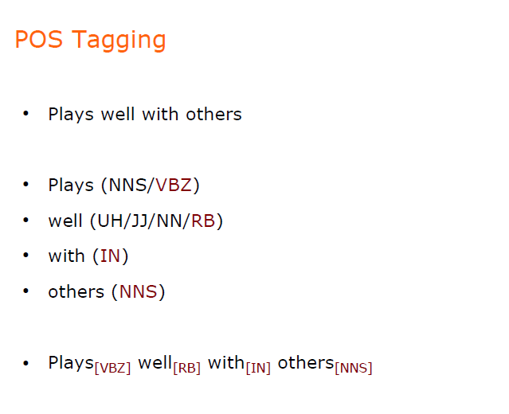
UH – Interjection Ex: ah,oops

Slide 50
The Problem
Words often have more than one word class: this
This is a nice day = PP$
This day is nice = DT
You can go this far = RB
Note: Tagsets distinguish between possessive pronouns (my, your, his, her, its) and Personal pronouns(I, you, he, me).
Possessive pronouns (PP$ in Penn Tag set) are likely to be followed by a noun: This is my book.
Personal pronoun (PP in Penn Tag set) are likely followed by a verb: I went to Mumbai

Slide 51
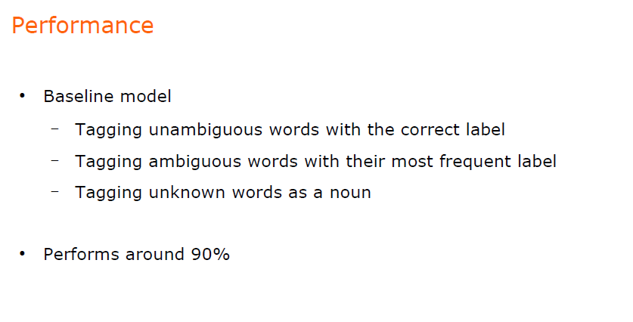

Slide 52
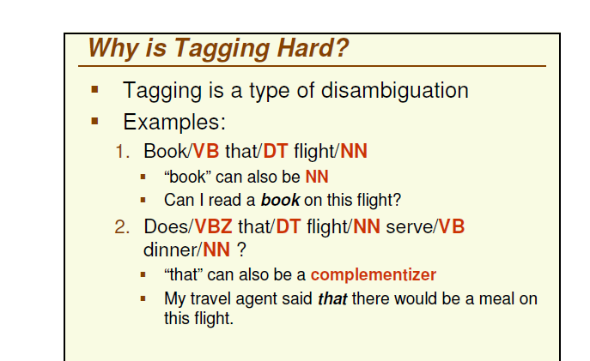

Slide 53
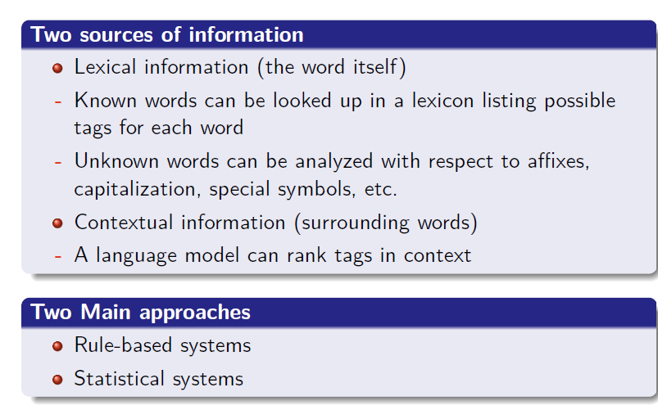

Slide 54
5.1 (Mostly) English Word classes

Slide 55
Part of speech – Closed classes
Prepositions: on, under, over, near, by at, from, with, to
Determiners: a, an, the
Pronouns: she, who, I, others
Conjunctions: and, but, as, or, if , when
Auxiliary verbs: can, may, should, are
Particles: up, on, off, in, out, at, by
numerals: one, two, three, first, second, third

Slide 56
Prepositions and subordinating conjunctions marked IN (although/IN)

Slide 57
Part of speech
Parts-of-speech can be divided into two broad categories: closed class types and open class types
Closed classes are those that have relatively fixed membership.
For example, prepositions are a closed class because there is a fixed set of them in English; new prepositions are rarely coined
By contrast nouns and verbs are open classes because new nouns and verbs are continually coined or borrowed from other languages
Example verb: to fax, blogging
Closed class words are also generally function words like of, it, and, or you, which tend to be very short, occur frequently, and often have structuring uses in grammar

Slide 58
Part of speech
It is likely that any given speaker or corpus will have different open class words
But all speakers of a language, and corpora that are large enough, will likely share the set of closed class word
There are four major open classes that occur in the languages of the world; nouns, verbs, adjectives, and adverbs
Nouns is the name given to the syntactic class in which the words for most people, places or things occur.

Slide 59
Part of speech
syntactic classes like nouns are defined syntactically and morphologically rather than semantically
Some words for people , places and things may not be nouns and conversely some nouns may not be words for people, places or things.
The nouns include concrete terms like ship and chair
abstractions like bandwidth and relationship
and verb-like terms like pacing Ex: His pacing to and fro became quite annoying.

Slide 60
Part of speech
Defining a noun in English:
its ability to occur with determiners
Ex: (a goat, its bandwidth, Plato's Republic)
to take possessives (IBM's annual revenue),
and for most but not all nouns, to occur in the plural form (goats, abaci)
Nouns are traditionally grouped into proper nouns and common nouns
Proper nouns, like Regina, Colorado, and IBM, are names of specific persons or entities
In English, they generally are not preceded by articles
proper nouns are usually capitalized

Slide 61
Part of speech
Common Nouns are divided into Mass Nouns and Count Nouns
Count nouns can occur in both the singular and plural
(goat/goats, relationship/relationships)
They can be counted (one goat, two goats)
Mass nouns are used when something is conceptualized as a homogeneous group.
salt, snow and communism are not counted (i.e., *two snows or *two communisms)
Mass nouns can also appear without articles where singular count nouns cannot
Snow is white but not *Goat is white

Slide 62
Part of speech
The verb class:
includes most of the words referring to actions and processes
including main verbs like draw, provide, differ, and go
English verbs have a number of morphological forms
(non-3rd-person-sg (eat), 3rd-person-sg (eats), progressive (eating), past tense-ed (ate)past participle (eaten)).

Slide 63
Part of speech
The third open class is adjectives
semantically this class includes many terms that describe properties or qualities.
adjectives are used for the concepts of
color (white, black),
age (old, young), and
value (good, bad)

Slide 64
Part of Speech
The final open class form: adverbs
Schachter (1985) pointed:
all the italicized words are adverbs
Unfortunately, John walked home extremely slowly yesterday
each of these words can be viewed as modifying something
often verbs, hence the name “adverb”,
But also other adverbs and entire verb phrases

Slide 65
Part of Speech
The final open class form: adverbs
Directional adverbs or locative adverbs (home, here, downhill) specify the direction or location of some action;
degree adverbs (extremely, very, somewhat) specify the extent of some action, process, or property;
manner adverbs (slowly, slinkily, delicately) describe the manner of some action
Temporal adverbs describe the time some action or event took place (Yesterday, Monday)
Note: Because of the heterogeneous nature of this class, some adverbs (Ex: temporal adverbs like Monday) are tagged in some tagging schemes as nouns.

Slide 66
Part of speech
Prepositions occur before noun phrases
semantically they are relational, indicating spatial or temporal relations
literal (on it, before then, by the house)
or metaphorical (on time, with gusto, beside herself)
Note: gusto - enthusiasm in doing something

Slide 67
Part of speech
A particle is a word that resembles a preposition or an adverb, and is used in combination with a verb
When a verb and a particle behave as a single syntactic and/or semantic unit, we call the combination a phrasal verb

Slide 68
Part of speech
Phrasal verbs can behave as a semantic unit
meaning not predictable from the separate meanings of the verb and the particle
Ex: turn down means ‘reject’
rule out means ‘eliminate’
find out is ‘discover’
go on is ‘continue’
Note: meanings cannot be predicted from the meanings of the verb and the particle independently

Slide 69
Part of speech
Examples of phrasal verbs from Thoreau
So I went on for some days cutting and hewing timber
Moral reform is the effort to throw off sleep.
Particles do not always occur with idiomatical phrasal verb semantics .. She had turned the paper over.
He arose slowly and brushed himself off
He packed up his clothes
Prepositions and subordinating conjunctions marked IN (although/IN)

Slide 70
Part of Speech
Particles vs. Prepositions
particles can either precede or follow a noun phrase object:
She told off/RP her friends
She told her friends off/RP
Prepositions, on the other hand, cannot follow their noun phrase
Note: * is used here to mark an ungrammatical sentence
She stepped off/IN the train
*She stepped the train off/IN

Slide 71
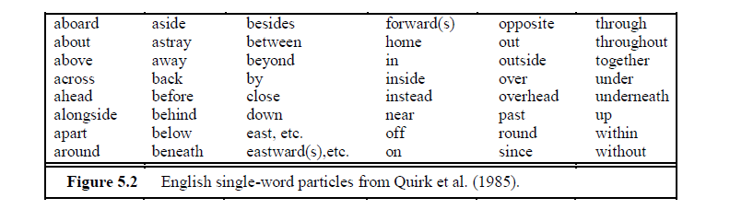
Part of speech
A list of single-word particles from Quirk et al. (1985)
Since it is extremely hard to automatically distinguish particles from prepositions
some tagsets (the one used for CELEX) do not distinguish them
even in corpora that do (like the Penn Treebank) the distinction is very difficult to make reliably in an automatic process

Slide 72
Part of speech – Determiners
A closed class that occurs with nouns, often marking the beginning of a noun phrase, is the determiners
subtype of determiners is the articles
English has three articles: a, an, and the
Other determiners include this (as in this chapter) and that (as in that page)
A and an mark a noun phrase as indefinite
the can mark it as definite
Articles are quite frequent in English; the is the most frequently occurring word in most corpora of written English.
COBUILD statistics, out of 16 million words:
the: 1,071,676 a: 413,887 an: 59,359

Slide 73
Part of speech - Conjunctions
Conjunctions are used to join two phrases, clauses, or sentences
Coordinating conjunctions - and, or, and but, join two elements of equal status
Subordinating conjunctions are used when one of the elements is of some sort of embedded status
Ex: that ―I thought that you might like some milk
is a subordinating conjunction
that links the main clause I thought
with the subordinate clause you might like some milk
This clause is called subordinate because this entire clause is the content of the main verb thought.
Subordinating conjunctions like that which link a verb to its argument in this way are also called complementizers.

Slide 74
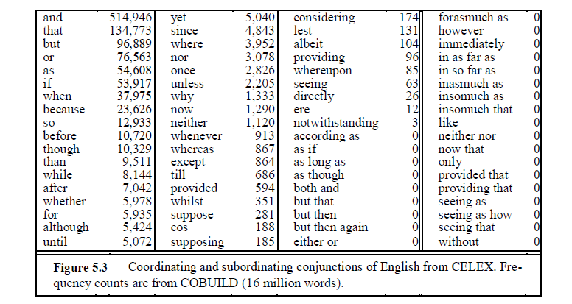
Part of speech - Conjunctions
English conjunctions

Slide 75
Part of Speech - Pronouns
Pronouns are forms that often act as a kind of shorthand for referring to some noun phrase or entity or event
Personal pronouns refer to persons or entities (you, she, I, it, me)
Possessive pronouns are forms of personal pronouns that indicate either actual possession or an abstract relation between the person and some object
(my, your, his, her, its, one's, our, their)
Wh-pronouns (what, who, whom, whoever) are used in certain question forms or may also act as complementizers (Frieda, who I met five years ago . . . )

Slide 76
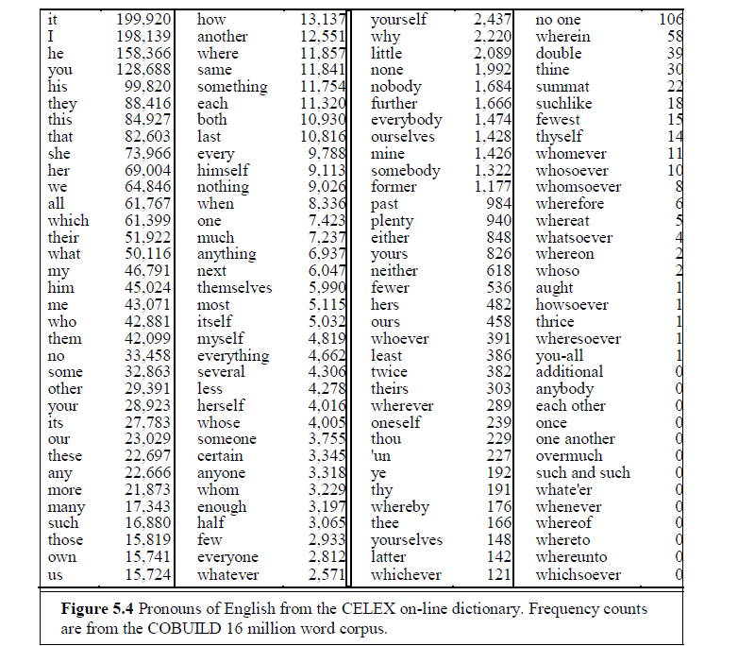
Part of Speech - Pronouns

Slide 77
Part of Speech – Closed class in Verbs - auxiliary verbs
A closed class subtype of English verbs are the auxiliary verbs
auxiliaries are words (usually verbs) that mark certain semantic features of a main verb
including whether an action takes place in the present, past or future (tense)
whether it is completed (aspect)
whether it is negated (polarity)
and whether an action is necessary, possible, suggested, desired, etc. (mood)

Slide 78
Part of Speech
English auxiliaries include
the copula verb be
the two verbs do and have, along with their inflected forms
a class of modal verbs
Be is called a copula
because it connects subjects with certain kinds of predicate nominals and adjectives (He is a duck)
The verb have is used to mark the perfect tenses (I have gone, I had gone)
be is used as part of the passive (We were robbed), or progressive (We are leaving) constructions
Note: A copular verb is a special kind of verb used to join an adjective or noun complement to a subject. Common examples are: be (is, am, are, was, were), appear, seem, look, sound, smell, taste, feel, become and get

Slide 79
copula verb be
A copula (plural: copulas or copulae) is a word used to link the subject of a sentence with a predicate (a subject complement)
Ex:"The sky is blue."
The word copula derives from the Latin noun for a "link" or "tie" that connects two different things
A copula is often a verb or a verb-like word, though this is not universally the case

Slide 80
Part of Speech – Modal verbs
The modal verbs - The modals are used to mark the mood associated with the event or action depicted by the main verb
can indicates ability or possibility
may indicates permission or possibility
must indicates necessity etc.
have appears as in – main verb vs. modal verb vs. non modal auxiliary verb
In addition to the perfect have mentioned above, there is a modal verb have (e.g., I have to go), which is very common in spoken English
Modal verbs - have and dare have zero frequency counts in Table
CELEX dictionary does not distinguish the main verb sense (I have three oranges, He dared me to eat them)
from the modal sense (There has to be some mistake, Dare I confront him?)
from the non-modal auxiliary verb sense (I have never seen that)
Note: main verb is seen

Slide 81
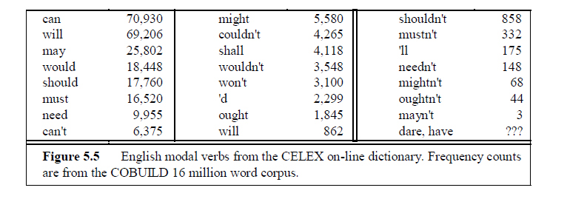
Part of Speech – Modal verbs
We use modal verbs to show if we believe something is certain, probable or possible (or not). We also use modals to do things like talking about ability, asking permission making requests and offers, and so on.

Slide 82
Part of Speech
English has many words of more or less unique function
interjections (oh, ah, hey, man, alas, uh, um)
negatives (no, not)
politeness markers (please, thank you)
greetings (hello, goodbye)
existential there (there are two on the table)
Note: above classes are either assigned particular tags or are lumped together (as interjections or even adverbs) depending on the purpose of the labeling

Slide 83
Part of Speech
Some tagging distinctions are quite hard for both humans and machines
Ex: prepositions (IN), particles (RP), and adverbs (RB) can have a large over-lap
Words like around can be all three:
Mrs. Shaefer never got around to joining
Mrs./NNP Shaefer/NNP never/RB got/VBD around/RP to/TO joining/VBG
All we gotta do is go around the corner
All/DT we/PRP gotta/VBN do/VB is/VBZ go/VB around/IN the/DT corner/NN
Chateau Petrus costs around 250
Chateau/NNP Petrus/NNP costs/VBZ around/RB 250/CD
Note: 1) get around: to be able to go to different places without difficulty: My grandmother is finding it harder to get around these days
Heuristics help human coders as well as for automatic taggers: Two heuristics from Santorini (1990) :
2) prepositions generally are associated with a following noun phrase (or followed by prepositional phrases)
3) around is tagged as an adverb when it means ―approximately

Slide 84
Part of Speech
Another difficulty : labeling the words that can modify nouns
Sometimes the modifiers preceding nouns are common nouns like cotton
other times the Tree-bank tagging manual specifies that modifiers be tagged as adjectives (for modifiers which are hyphenated common noun like income-tax
other times as proper nouns (for modifiers which are hyphenated proper nouns like Gramm-Rudman)
cotton/NN sweater/NN
income-tax/JJ return/NN
the/DT Gramm-Rudman/NP Act/NN

Slide 85
Part of Speech
Some words that can be adjectives, common nouns, or proper nouns, are tagged in the Treebank as common nouns when acting as modifiers:
Chinese/NN cooking/NN
Pacific/NN waters/NNS

Slide 86
Part of Speech
A third known difficulty in tagging is distinguishing past participles (VBN) from adjectives (JJ)
A word like married is a past participle when it is used in an eventive, verbal way, as in (1) , and is an adjective when it is being used to express a property, as in (2):
They were married/VBN by the Justice of the Peace yesterday at 5:00
At the time, she was already married/JJ.

Slide 87
Part of Speech
Brown has the tag NR for adverbial nouns like home, west, Monday, and tomorrow
The Treebank lacks this tag, it has a much less consistent policy for adverbial nouns; Monday, Tuesday, and other days of the week are marked NNP, tomorrow, west, and home are marked sometimes as NN, sometimes as RB.
This makes the Treebank tagset less useful for high-level NLP tasks like the detection of time phrases.
The Treebank tagset has been the most widely used in evaluating tagging algorithms
many of the algorithms have been evaluated mainly on this tagset
Usefulness of a tagset for a particular application depends on how much information the application needs

Slide 88
Prepositions and subordinating conjunctions marked IN (although/IN)

Slide 89
Three Methods for POS Tagging
Rule-based
Hand-coded rules
Probabilistic/Stochastic
Sequence (n-gram) models; machine learning
HMM (Hidden Markov Model)
MEMMs (Maximum Entropy Markov Models)
Transformation-based
Rules + n-gram machine learning
Brill tagger

Slide 90
Part of Speech
Most tagging algorithms fall into one of two classes:
rule-based taggers and stochastic taggers
Rule-based taggers involve a large database of hand-written disambiguation rules
It specifies, for example, that an ambiguous word is a noun rather than a verb if it follows a determiner.

Slide 91
Part of Speech
Stochastic taggers
Resolve tagging ambiguities by using a training corpus to compute the probability of a given word having a given tag in a given context.
The Hidden Markov Model or HMM tagger

Slide 92
Part of Speech
transformation-based tagger or the Brill tagger, after Brill (1995)
The Brill tagger shares features of both tagging architectures.
Like the rule-based tagger
based on rules which determine when an ambiguous word should have a given tag.
Like the stochastic taggers
has a machine-learning component:
the rules are automatically induced from a previously tagged training corpus

Slide 93
Rule-Based POS Tagging
“Two-level morphology” scheme (used in ENGTWOL)
Start with a dictionary
[Stage 1] Assign all possible tags to words from the dictionary
[Stage 2] Write rules by hand to selectively remove tags
Leaving the correct tag for each word.

Slide 94
Rule-Based POS Tagging – Problem Statement
Apply Rule based POS tagging to the following sentence:
She promised to back the bill
Method:
Start with a dictionary
[Stage 1] Assign all possible tags to words from the dictionary
[Stage 2] Write rules by hand to selectively remove tags
Leaving the correct tag for each word.

Slide 95
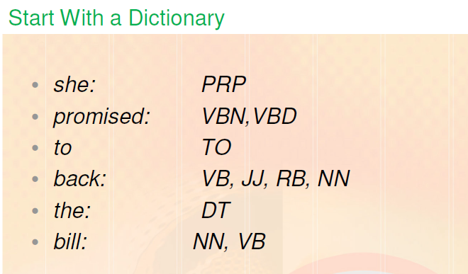
Rule-Based POS Tagging
[Stage 1] Assign all possible tags to words from the dictionary
Note: she is personal pronoun with a tag /PP in Penn Tree bank tag set

Slide 96
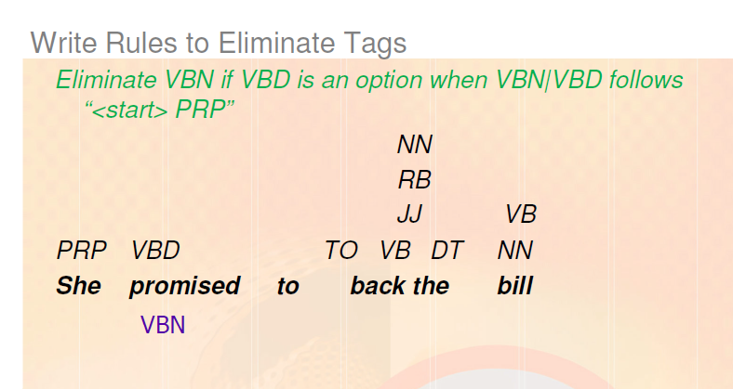
Rule-Based POS Tagging
[Stage 2] Write rules by hand to selectively remove tags
promised - VBD, back – VB and bill - NN

Slide 97
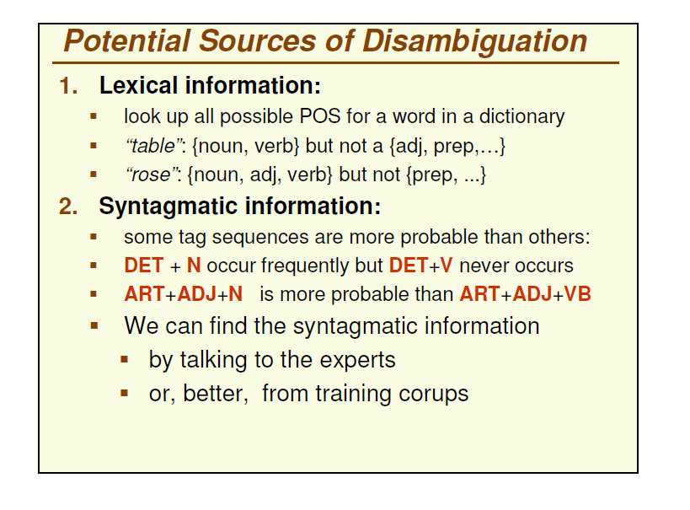

Slide 98
Stage 1 of ENGTWOL Tagging
A sample rule-based tagger, EngCG, based on the Constraint Grammar architecture
First Stage: Run words through FST morphological analyzer to get all parts of speech.
Example: “Pavlov had shown that salivation …”
Pavlov PAVLOV N NOM SG PROPER had HAVE V PAST VFIN SVO HAVE PCP2 SVO shown SHOW PCP2 SVOO SVO SV that ADV PRON DEM SG DET CENTRAL DEM SG CS salivation N NOM SG

Slide 99
Stage 2 of ENGTWOL Tagging
Second Stage: Apply NEGATIVE constraints.
Example: Adverbial “that” rule
Eliminates all readings of “that” except the one in
“It isn’t that odd”
Given input: “that” If (+1 A/ADV/QUANT) ; if next word is adj/adv/quantifier
(+2 SENT-LIM) ; following which is E-O-S
(NOT -1 SVOC/A) ; and the previous word is not a
; verb like “consider” which
; allows adjective complements
; in “I consider that odd”
Then eliminate non-ADV tags Else eliminate ADV

Slide 100
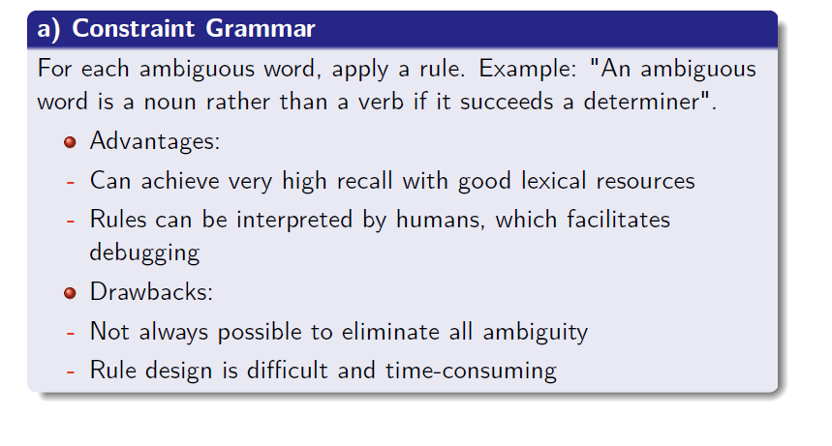
Rule-Based POS Tagging – Advs and Drawbacks

Slide 101
Probabilistic POS Tagging

Slide 102
Probabilistic POS Tagging
Tagging with lexical frequencies Secretariat is expected to race/VB tomorrow
Secretariat/NNP is/VBZ expected/VBN to/TO race/VB tomorrow/NN
People continue to inquire the reason for the race/NN for outer space
People/NNS continue/VBP to/TO inquire/VB the/DT reason/NN for/IN the/DT race/NN for/IN outer/JJ space/NN
Problem: assign a tag to “race” given its lexical frequency
Solution: choose the tag that has the greater conditional probability - a probability of the word in a given POS
P(race|VB)
P(race|NN)

Slide 103
Unigram Tagger
Train on a set of sentences
Keep track of how many times each word is seen with each tag.
After training, associate with each word its most likely tag.
Problem: many words never seen in the training data.
Solution: have a default tag to “backoff” to.
More problems…
Most frequent tag is not always right!
Need to take the context into account
Which sense of “to” is being used?
Which sense of “like” is being used?
Note : “cutoff” is the minimal number of times that the context must have been seen in training in order to be incorporated into the statistics
Default cutoff is 1

Slide 104
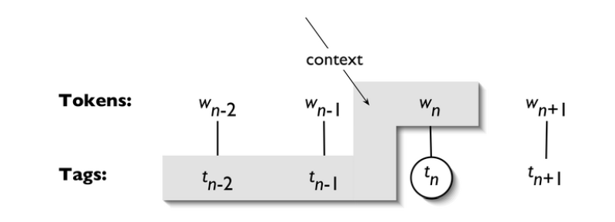
N-gram Tagger
Uses the preceding N-1 predicted tags
Also uses the unigram estimate for the current word

Slide 105
Probabilistic POS Tagging
N-grams
The N stands for how many terms are used/looked at
Unigram: 1 term (0th order)
Bigram: 2 terms (1st order)
Trigrams: 3 terms (2nd order)
Usually don’t go beyond this
use n-grams to help determine the context in which some linguistic phenomenon happens.
e.g., Look at the words before and after the period to see if it is the end of a sentence or not.

Slide 106
How N-gram Tagger Works
Constructs a frequency distribution describing the frequencies each word is tagged with in different contexts.
The context considered consists of the word to be tagged and the n-1 previous words' tags.
After training, tag words by assigning each word the tag with the maximum frequency given its context.
Assigns “None” tag if it sees a word in a context for which it has no data (which it has not seen).
Tuning parameters
“cutoff” is the minimal number of times that the context must have been seen in training in order to be incorporated into the statistics
Default cutoff is 1

Slide 107
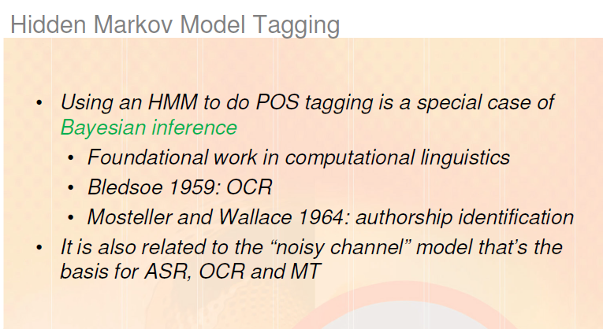
Note: Bayesian inference or Bayesian classification was applied successfully to language problems in 1950s

Slide 108
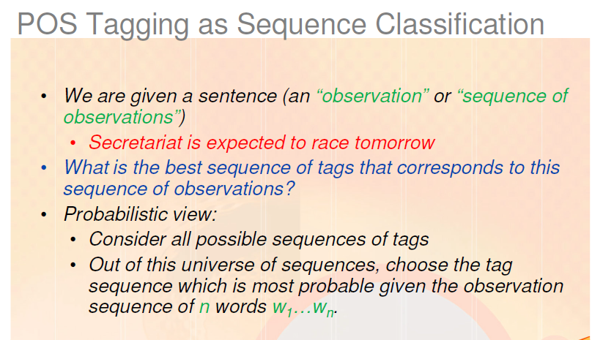

Slide 109
HMM Part of Speech Tagging
Classification task
In a classification task, we are given some observation(s)
job is to determine which of a set of classes it belongs to.
Part-of-speech tagging is treated as a sequence classification task
Observations?
the observation is a sequence of words – say in a sentence
job is to assign them a sequence of part-of-speech tags
Ex: we are given a sentence like
(1) Secretariat is expected to race tomorrow.

Slide 110
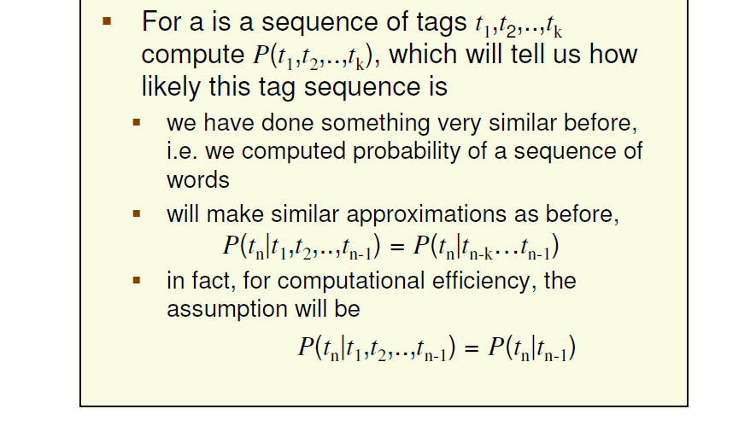
Background
Stochastic tagging algorithm known as the Hidden Markov Model or HMM tagger

Slide 111
POS Tagging as Sequence Classification
We are given a sentence (an “observation” or “sequence of observations”)
Secretariat is expected to race tomorrow
What is the best sequence of tags that corresponds to this sequence of observations?
Probabilistic view: The Bayesian interpretation
Consider all possible sequences of tags
Out of this universe of sequences, choose the tag sequence which is most probable given the observation sequence of n words w₁…w_{n}.

Slide 112
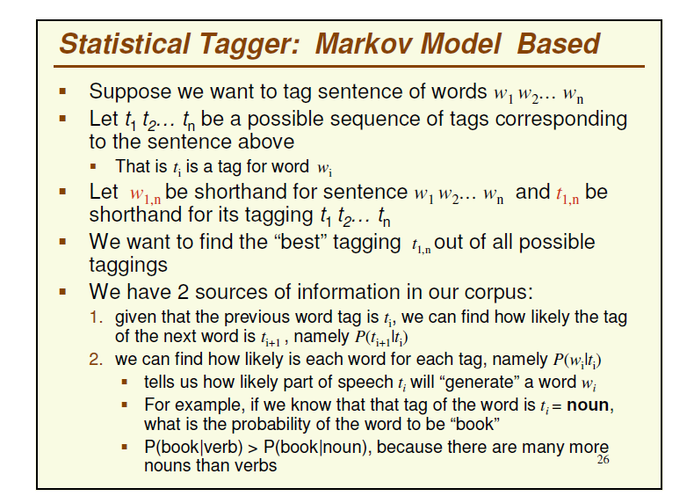
HMM Part of Speech Tagging

Slide 113
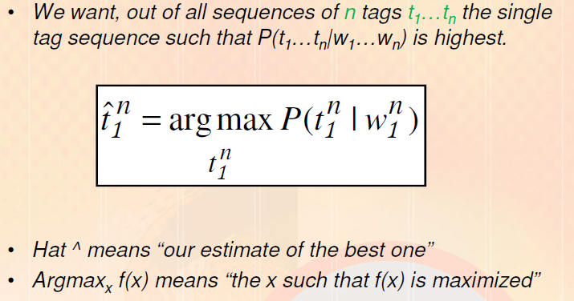
HMM Part of Speech Tagging

Slide 114

HMM Part of Speech Tagging

Slide 115
Bayes Rule
Way to derive the probability of x given y
When we know:
the probability of y given x,
The probability of x and
the probability of y
P(x | y )= P( y | x )P( x)
_____________
P( y )

Slide 116
Bayes Rule
Way to derive the probability of x given y

Slide 117

HMM Part of Speech Tagging

Slide 118
HMM Part of Speech Tagging
Simplification: Drop the denominator
Denominator is same for all the tag sequences (the word sequence is given)
Also P(w1,n) does not change for each tag sequence;
we are always asking about the most likely tag sequence for the same observation w1,n which must have the same probability P(w1,n)
For each tag sequence calculate the product of:
The probability of the word sequence given the tag sequence (likelihood)
The probability of the tag sequence (prior probability)
Still too hard

Slide 119

HMM Part of Speech Tagging

Slide 120

Back ground – Chain rule

Slide 121

Background – Markov assumption

Slide 122
HMM Part of Speech Tagging
2 simplifying assumptions
make it possible to estimate the probability of tag sequences given word sequences:
1) the probability of a word is only dependent on its own POS tag - likelihood
that it is independent of other words around it, and of the other tags around it
2) the probability of a POS tag is only dependent on the previous POS tag - prior

Slide 123

HMM Part of Speech Tagging

Slide 124


Disambiguating “race”
Note: In 45-tag Penn tagset time-adverbs like tomorrow are tagged as NN;
In 87-tag Brown tagset they appear as NR which is Adverbial noun such as home, west, tomorrow, Friday, North.
In Penn Tagset, NNP is proper noun

Slide 125

HMM Part of Speech Tagging
P(NN|DT) - If we were expecting a determiner tag DT, how likely is it that the next POS tag would be NN?

Slide 126

HMM Part of Speech Tagging
P(is|VBZ) - If we were expecting a third person singular verb, how likely is it that this verb would be is?

Slide 127

HMM Part of Speech Tagging - Summary

Slide 128
5.5.1 Computing the most-likely tag sequence: A motivating example
The previous section summary:
the HMM tagging algorithm chooses as the most likely tag sequence the one that maximizes the product of two terms;
the probability of the sequence of tags, and the probability of each tag generating a word.
Now, show for a sentence
how the correct tag sequence achieves a higher probability
than one of the many possible wrong sequences.

Slide 129
5.5.1 Computing the most-likely tag sequence: A motivating example
In (1) race is a verb (VB) while in (2) race is a common noun (NN):
Secretariat is expected to race/VB tomorrow
Secretariat/NNP is/VBZ expected/VBN to/TO race/VB tomorrow/NR
2. People continue to inquire the reason for the race/NN for outer space
People/NNS continue/VBP to/TO inquire/VB the/DT reason/NN for/IN the/DT race/NN for/IN outer/JJ space/NN
Problem: resolve the part-of-speech ambiguity of the word race
can be a noun or a verb in English
Note: In 45-tag Penn tagset time-adverbs like tomorrow are tagged as NN;
In 87-tag Brown tagset they appear as NR which is Adverbial noun such as home, west, tomorrow, Friday, North.
In Penn Tagset, NNP is proper noun

Slide 130
5.5.1 Computing the most-likely tag sequence: A motivating example
How race can be correctly tagged as a VB instead of an NN in (1)?
HMM part-of-speech taggers resolve this ambiguity globally rather than locally, picking the best tag sequence for the whole sentence.
There are many hypothetically possible tag sequences for (1):
since there are other ambiguities in the sentence
(for example expected can be an adjective (JJ), a past tense/preterite (VBD) or a past partici-ple (VBN)).
But consider two of the potential sequences, shown next
these sequences differ only in one place; whether the tag chosen for race is VB or NN

Slide 131

5.5.1 Computing the most-likely tag sequence: A motivating example

Slide 132
Disambiguating “race”

Slide 133
5.5.1 Computing the most-likely tag sequence: A motivating example
Almost all the probabilities in these two sequences are identical;
highlight in boldface show the three probabilities that differ.
consider two of these, corresponding to P(ti|ti−1) and P(wi |ti).
The transition probability P(ti |ti−1)
Fig (a) is P(VB|TO)
Figure (b) the transition probability is P(NN|TO)
The tag transition probabilities P(VB|TO) and P(NN|TO) give the answer to the question

Slide 134
5.5.1 Computing the most-likely tag sequence: A motivating example
How likely to expect a verb (noun) given the previous tag?
the maximum likelihood estimate for these probabilities can be derived from corpus counts.
87-tag Brown corpus gives the following probabilities, showing that verbs are about 500 times as likely as nouns to occur after TO:
P(VB|TO) = .83
P(NN|TO) = .00047

Slide 135
5.5.1 Computing the most-likely tag sequence: A motivating example
P(wi |ti), the lexical likelihood of the word race given a part-of-speech tag
For the two possible tags VB and NN, these correspond to the probabilities P(race|VB) and P(race|NN).
the lexical likelihoods from Brown:
P(race|VB) = .00012
P(race|NN) = .00057

Slide 136
Disambiguating “race”
Represent the tag sequence probability for the NR tag
the tag NR for tomorrow:
P(NR|VB) = .0027
P(NR|NN) = .0012

Slide 137
Disambiguating “race”

Slide 138
5.5.1 Computing the most-likely tag sequence: A motivating example
multiply the lexical likelihoods with the tag sequence probabilities
P(VB|TO)P(NR|VB)P(race|VB) = .00000027
P(NN|TO)P(NR|NN)P(race|NN) = .00000000032
The final result
we see that the probability of the sequence with the VB tag is higher
the HMM tagger correctly tags race as a VB

Slide 139
Hidden Markov Models (HMM)
The n-gram example shown earlier is essentially a Hidden Markov Model (HMM)
Definitions:
A weighted finite-state automaton(WFSA) adds probabilities to the arcs
The sum of the probabilities leaving any arc must sum to one
A Markov chain is a special case of a WFSA in which the input sequence uniquely determines which states the automaton will go through
Markov chains can not represent inherently ambiguous problems
Useful for assigning probabilities to unambiguous sequences

Slide 140

Markov Chain for Words

Slide 141
Markov Chain: “First-order observable Markov Model”
A set of states
Q = q₁, q₂…q_{N;} the state at time t is q_{t}
Transition probabilities:
a set of probabilities A = a₀₁a₀₂…a_{n1}…a_{nn}.
Each a_{ij} represents the probability of transitioning from state i to state j
The set of these is the transition probability matrix A
Current state only depends on previous state

Slide 142
Hidden Markov Model (1)
In part-of-speech tagging
The output symbols are words
But the hidden states are part-of-speech tags
So we need an extension!
A Hidden Markov Model is an extension of a Markov chain in which the input symbols are not the same as the states.
This means we do not know which state we are in.

Slide 143
Hidden Markov Model (2)
States Q = q₁, q₂…q_{N;}
Observations O= o₁, o₂…o_{N;}
Each observation is a symbol from a vocabulary V = {v₁,v₂,…v_{V}}
Transition probabilities
Transition probability matrix A = {a_{ij}}
Observation likelihoods
Output probability matrix B={b_{i}(k)}
Special initial probability vector π

Slide 144

Transition Probabilities

Slide 145

Observation Likelihoods

Slide 146
Imagine a corpus tagged by hand ( words are to be shown)
Adj Verb Noun Adj Verb Adj Noun Adj
1)We can for instance compute this information: P(Noun|Verb)=1/2 2) this information: P(bu|Adj)=2/4
Instructions:
Take the corpus above and:
With a red pen, arrow or circle the example of information 1)
With a green pen arrow or circle the example of information 2)
With your own words formulate which kind of information it is

Slide 147
Defines the information we need to build a Hidden Markov Model (HMM) for tagging

Slide 148
Note: Only “Decoding” in our syllabus

Slide 150
Example – We need an efficient algorithm
If each word can have up to T tags and there are N words, How many possible tag sequences by brute- force?

Slide 151

Decoding
Recall that we need to get
We could just enumerate all paths given the input and use the model to assign probabilities to each.
Not a good idea. Computationally intractable !
Dynamic programming can help!
The number of possible tag sequences is exponential in the length of the input sentence:
Each word can have up to T tags. There are N words. There are up to T^{N} possible tag sequences.
We cannot enumerate all T^{N} possible tag sequences.

Slide 152
The Viterbi Algorithm for HMM Tagging
Decoding:
For any model, such as an HMM, that contains hidden variables, the task of determining which sequence of variables is the underlying source of some sequence of observations is called the decoding task.
The Viterbi algorithm is the most common decoding algorithm used for HMMs, whether for part-of-speech tagging or for speech recognition.
The term Viterbi is common in speech and language processing, but is really a standard application of the classic dynamic programming algorithm and looks like the minimum edit distance algorithm of Ch. 3.

Slide 153

The Viterbi Algorithm for HMM Tagging - Problem statement
Viterbi algorithm :
Input: a single HMM and a set of observed words O = (o1o2o3 . . . oT ) and
Returns: the most probable state/tag sequence Q = (q1q2q3 . . . qT ), together with its probability.
Problem statement : Apply Viterbi algorithm for “I want to race” and find the best possible tag sequence

Slide 154
The Viterbi Algorithm for HMM Tagging
Let the HMM be defined by the two tables
Fig. 5.15 expresses the a ij probabilities, the transition probabilities between hidden states (i.e. part-of-speech tags).
Fig. 5.16 expresses the bi(ot ) probabilities, the observation likelihoods of words given tags.

Slide 155

The Viterbi Algorithm for HMM Tagging
Note: PPSS tag in 87- tag Brown refers to “ other nominative pronoun” such as I, we, they

Slide 156
The Viterbi Algorithm for HMM Tagging
The Viterbi algorithm sets up a probability matrix:
with one column for each observation t and
one row for each state in the state graph.
Each column thus has a cell for each state qi in the single combined automaton for the four words.

Slide 157
The Viterbi Algorithm for HMM Tagging - Procedure
The algorithm first creates N or four state columns.
The first column corresponds to the observation of the first word I,
the second to the second word want,
the third to the third word to, and
the fourth to the fourth word race.
begin in the first column by setting the viterbi value in each cell to the product of the transition probability (into it from the state state) and the observation probability (of the first word);
For each state qj at time t, the value viterbi[s, t] is computed by taking the maximum over the extensions of all the paths that lead to the current cell

Slide 158
Viterbi Summary
Create an array
With columns corresponding to inputs
Rows corresponding to possible states
Sweep through the array in one pass filling the columns left to right using our transition probabilities and observations probabilities
Dynamic programming key is that we need only store the MAX probability path to each cell, (not all paths).

Slide 159


The Viterbi Algorithm for HMM Tagging
The three factors that are multiplied for extending the previous paths to compute the Viterbi probability at time t are:

Slide 160

Viterbi Example

Slide 161


The Viterbi Algorithm

Slide 162
The Viterbi Algorithm for HMM Tagging
Problem: Compute Viterbi Matrix for “learning changes thoroughly” and specify the best POS tag sequence.

Slide 163
POS-tagging Evaluation
Evidence of the power of statistical methods over rule-based methods
Accuracy of 90% of stochastic tagger
contrast with 77% accuracy of the rule-based tagger
The result is compared with a manually annotated (coded) “Gold Standard” test set
Error rates on known vs. unknown words
Error rates on particular tags
Typically accuracy reaches 96-97% for English newswire text
This may be compared with result for a baseline tagger (one that uses no context).
Important: 100% is impossible even for human annotators.

Slide 164
Transformation-Based Tagger

Slide 165
Transformation-Based Tagger
Transformation-Based Tagging called Brill tagging
an instance of the Transformation-Based Learning (TBL) approach to machine learning
draws inspiration from both the rule-based and stochastic taggers
Like the rule-based taggers,
TBL is based on rules that specify what tags should be assigned to what words.
But like the stochastic taggers, TBL is a machine learning technique, in which rules are automatically induced from the data.
TBL is a supervised learning technique; it assumes a pre-tagged training corpus

Slide 166
Transformation-Based Tagger
The TBL algorithm has a set of tagging rules.
A corpus is first tagged using the broadest rule, that is, the one that applies to the most cases.
Then a slightly more specific rule is chosen, which changes some of the original tags.
Next an even narrower rule, which changes a smaller number of tags

Slide 167
Examples
Examples:
They are expected to race tomorrow.
The race for outer space.
Tagging algorithm:
Tag all uses of “race” as NN (most likely tag in the Brown corpus)
They are expected to race/NN tomorrow
the race/NN for outer space
Use a transformation rule to replace the tag NN with VB for all uses of “race” preceded by the tag TO:
They are expected to race/VB tomorrow
the race/NN for outer space

Slide 168
Transformation-Based Tagger- How TBL Rules Are Applied
Before the rules apply, the tagger labels every word with its most-likely tag.
We get these most-likely tags from a tagged corpus.
Ex: in the Brown corpus, race is most likely to be a noun:
P(race | NN) = .98
P(race | VB) = .02
Examples of race will both be coded as NN. In the first case, this is a mistake, as NN is the incorrect tag:
(1) is/VBZ expected/VBN to/TO race/NN tomorrow/NN
In the second case this race is correctly tagged as an NN:
(2) the/DT race/NN for/IN outer/JJ space/NN
After selecting the most-likely tag, Brill's tagger applies its transformation rules.
Brill's tagger learned a rule that applies exactly to this mis-tagging of race:
Change NN to VB when the previous tag is TO
This rule would change race/NN to race/VB
(1) expected/VBN to/TO race/NN → expected/VBN to/TO race/VB

Slide 169
Transformation-Based Tagger - How TBL Rules Are Learned
Brill's TBL algorithm has three major stages
It first labels every word with its most-likely tag
It then examines every possible transformation, and selects the one that results in the most improved tagging.
Finally, it then re-tags the data according to this rule.
The last two stages are repeated until some stopping criterion is reached, such as insufficient improvement over the previous pass.
Note that stage two requires that TBL knows the correct tag of each word; that is, TBL is a supervised learning algorithm.

Slide 170
Transformation-Based Tagger - How TBL Rules Are Learned
The output of the TBL process is an ordered list of transformations;
These constitute a ―tagging procedure that can be applied to a new corpus.
In principle the set of possible transformations is infinite, since we could imagine transformations such as ―transform NN to VB if the previous word was ―IBM and the word ―the occurs between 17 and 158 words before that.
But TBL needs to consider every possible transformation, in order to pick the best one on each pass through the algorithm.
Thus the algorithm needs a way to limit the set of transformations.
This is done by designing a small set of templates (abstracted transformations).
Every allowable transformation is an instantiation of one of the templates

Slide 171
Brill Tagger: In more detail
Start with simple (less accurate) rules…learn better ones from tagged corpus
Tag each word initially with most likely POS
Examine set of transformations to see which improves tagging decisions compared to tagged corpus
Re-tag corpus using best transformation
Repeat until, e.g., performance does not improve
Result: tagging procedure (ordered list of transformations) which can be applied to new, untagged text

Slide 172

Sample Transformation Rules

Slide 173
Transformation-Based Tagging
3/2/2020
173
Basic Idea: Strip tags from tagged corpus and try to learn them by rule application
For untagged, first initialize with most probable tag for each word
Change tags according to best rewrite rule, e.g. “if word-1 is a determiner and word is a verb then change the tag to noun”
Compare to gold standard
Iterate
Rules created via rule templates, e.g.of the form if word-1 is an X and word is a Y then change the tag to Z”
Find rule that applies correctly to most tags and apply
Iterate on newly tagged corpus until threshold reached
Return ordered set of rules
NB: Rules may make errors that are corrected by later rules
Notes:
173

Slide 174
Evaluating Tagging Approaches
For any NLP problem, we need to know how to evaluate our solutions
Possible Gold Standards -- ceiling:
Annotated naturally occurring corpus
Human task performance (96-97%)
How well do humans agree?
Can be hard to obtain for some tasks: sometimes humans don’t agree

